Slide 1
to Mrs. Perez’s 2nd-4th grade class!

Slide 2
This year will be my 8th years of teaching and my 3rd year in Country Springs!
I have a sister with Down’s Syndrome. Who makes vital decisions for me.

Slide 3
ClassDojo Messages
joann_perez@chino.k12.ca.us
(909) 590-8212

Slide 4
Communication is key!
Use ClassDojo for school progress and discipline
Weekly Communication page (optional)

Slide 5
Classroom aides: Ms. Priscilla (Ms. P), Ms. Meranda, and Ms. Elena
Service Providers:
Ms. Heather (speech)
Ms. Lindsey (APE)
Ms. Claudia (OT)
Mr. Kevin (school psychologist)

Slide 6
Curriculum
English Language Arts (ELA):
Wonders
Math:
Savvas
Science & Social Studies:
News 2 You
Computer Platform used:
Splashlearn
IXL

Slide 7
Grading/Report Cards
4 Excelling – Students at the Excelling level of performance are consistently performing at grade level, can demonstrate independence, and can extend the grade level standards, when applicable, expected at this point of the school year. ​
3 Achieving – Students at the Achieving level of performance demonstrate an adequate understanding of and ability to apply skills needed to meet grade level standards expected at this point of the school year. ​
2 Progressing – Students at the Progressing level of performance are partially meeting the grade level standards expected at this point in the school year. ​
1 Beginning/Standard Not Met – Students at the Beginning/Standard Not Met are not yet meeting the grade level standards expected at this point of the school year. Performance level marks describe students’ progress toward year-end standards. ​

Slide 8
Please remember to place your child’s folders in their backpack every school day! We have important flyers, HW, documents, and school events placed in their folder.
Please do not place forms in your child’s backpack only in their folders.
Thank you!

Slide 9
Homework Expectations
Homework will be available on paper or computer.
Teachers shall encourage parents/guardians to read and discuss stories with to their children.
Homework will be assigned four days per week (Monday through Thursday) and shall promote the development of skills and encourage family participation. Parents/guardians shall be informed about:
· Homework expectations
· How homework relates to the student’s needs
· How best to help your children

Slide 10
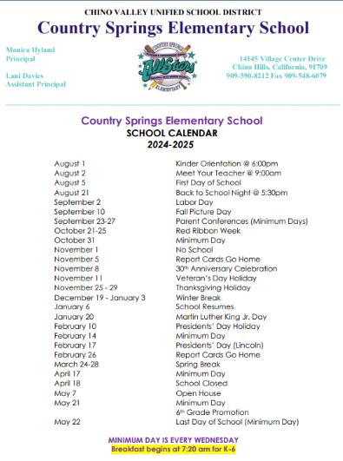
School Calendar
2024-2025
Found on school website.

Slide 11
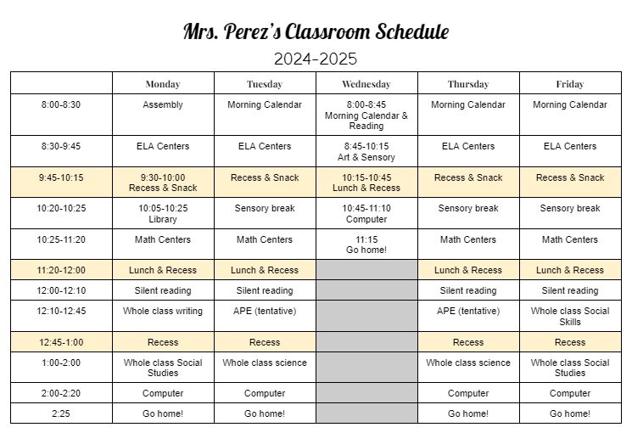
Daily Schedule

Slide 12
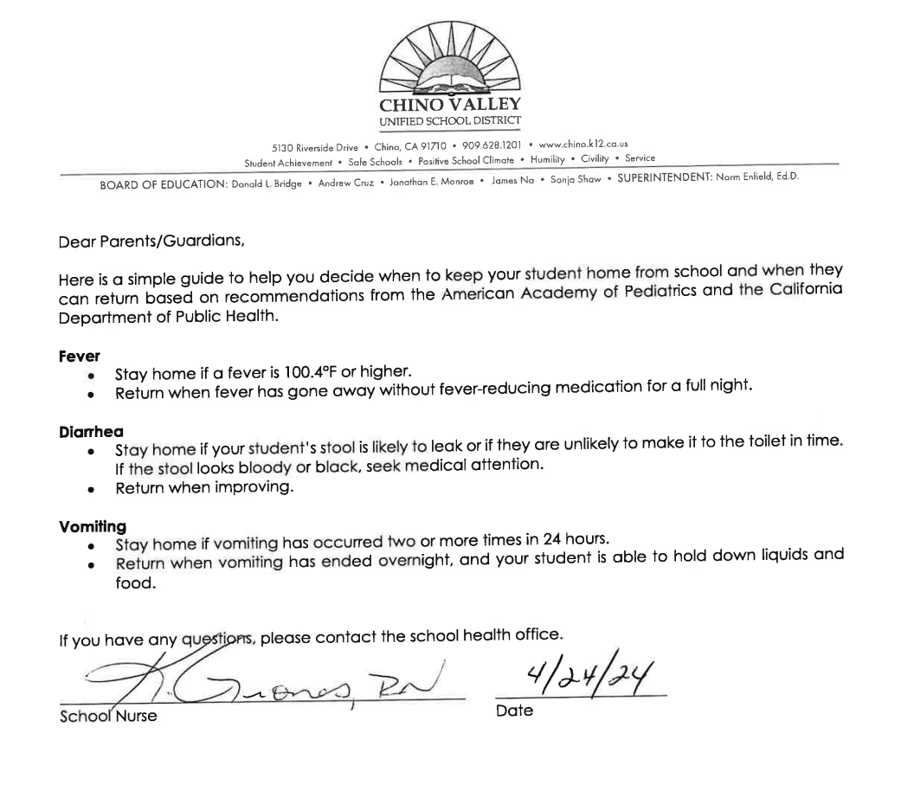
It’s very important for students to attend school on time and daily! Consistency is key!
Any doctors, dental, or other important appointments, please schedule them outside of school time.
Click me!

Slide 13
The following performance marks will be given for tardies/unexcused absences per trimester at a minimum. Other factors can contribute to a lower performance mark. Parents will receive notice from the school after 3 and 6 tardies.
Tardies
1-2 tardies = 4
3-4 tardies = 3
5-6 tardies = 2
7+ = 1
Unexcused absences
2+ unexcused absences = 3
Excused absence does not affect their grade

Slide 14
We are a PBIS (Positive Behavioral Interventions and Supports) school!
Be respectful
Be responsible
Be safe

Slide 15
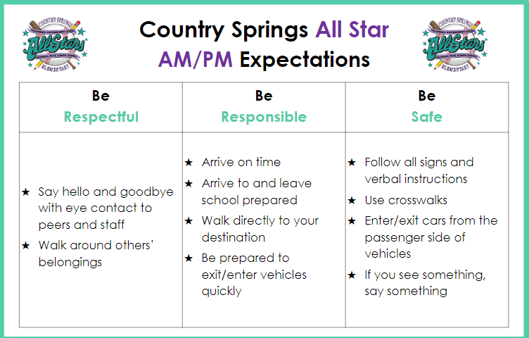

Slide 17
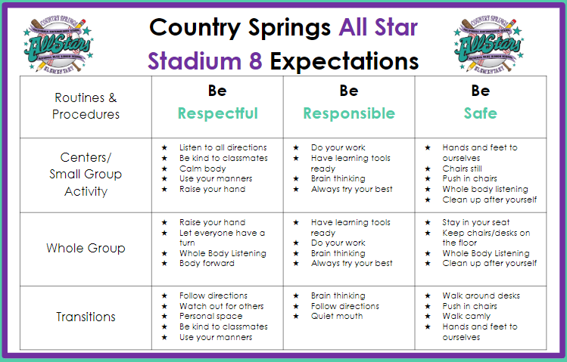
Our Classroom

Slide 18
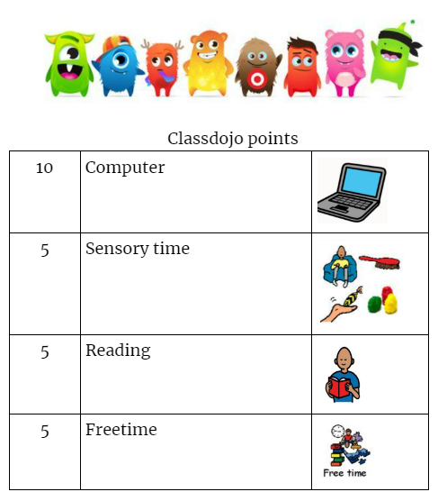
PBIS Trading Cards
ClassDojo points
Individualized token boards

Slide 19
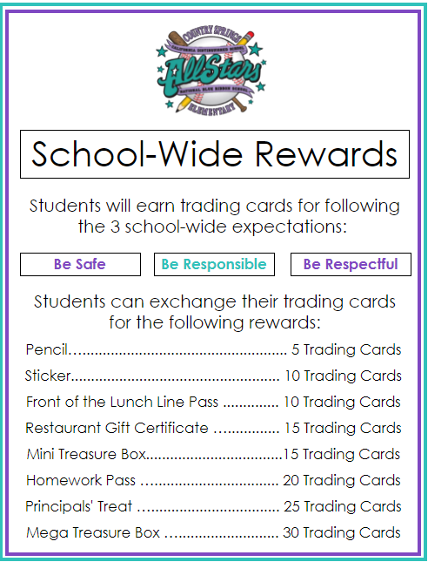
Trading Cards
Students are recognized for following our school-wide expectations by earning a Trading Card. We hold a Trading Card Exchange where students are able to exchange their cards for various rewards.

Slide 20
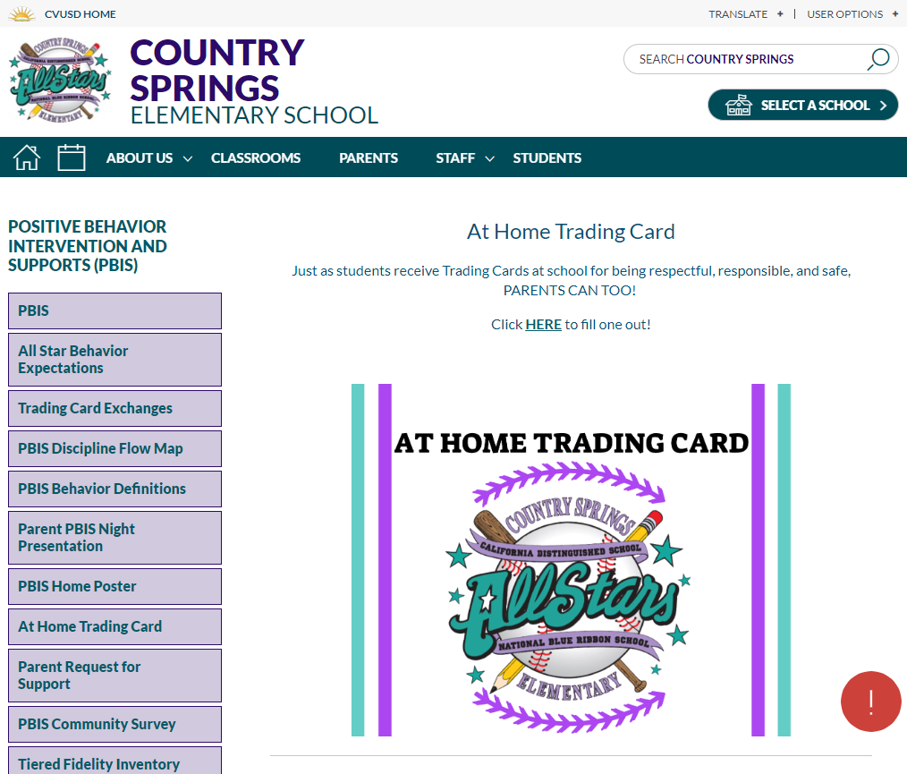
At Home Trading Card
Just as students receive Trading Cards at school for
being respectful, responsible, and safe, PARENTS CAN TOO!
Here is the link to take you to the At Home Trading Card:
https://www.chino.k12.ca.us/Page/55424

Slide 21
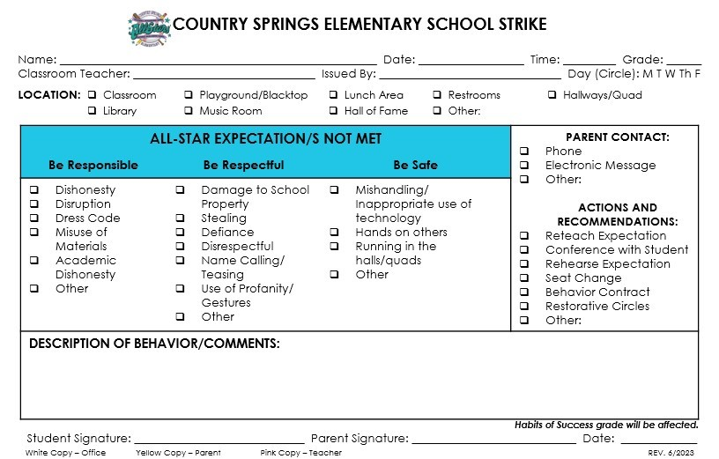
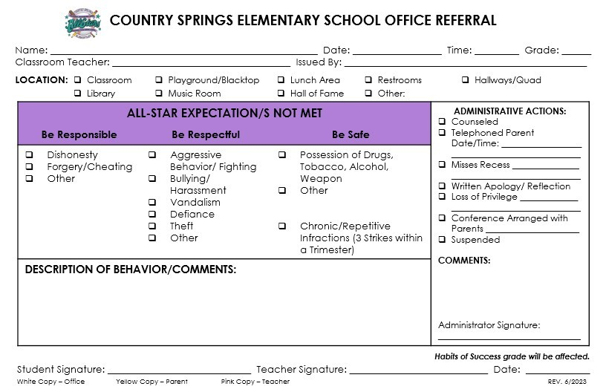
Strikes and Referrals
Minor Behaviors
The Strike is a form of communication between the school and the parent/guardian. After having a conversation about the Strike with your child, please have your child return the signed Strike to school the next day.
Major Behaviors
The student meets with an administrator for counseling and development of a “plan” for correcting inappropriate behavior. Parents are contacted by administration.

Slide 22
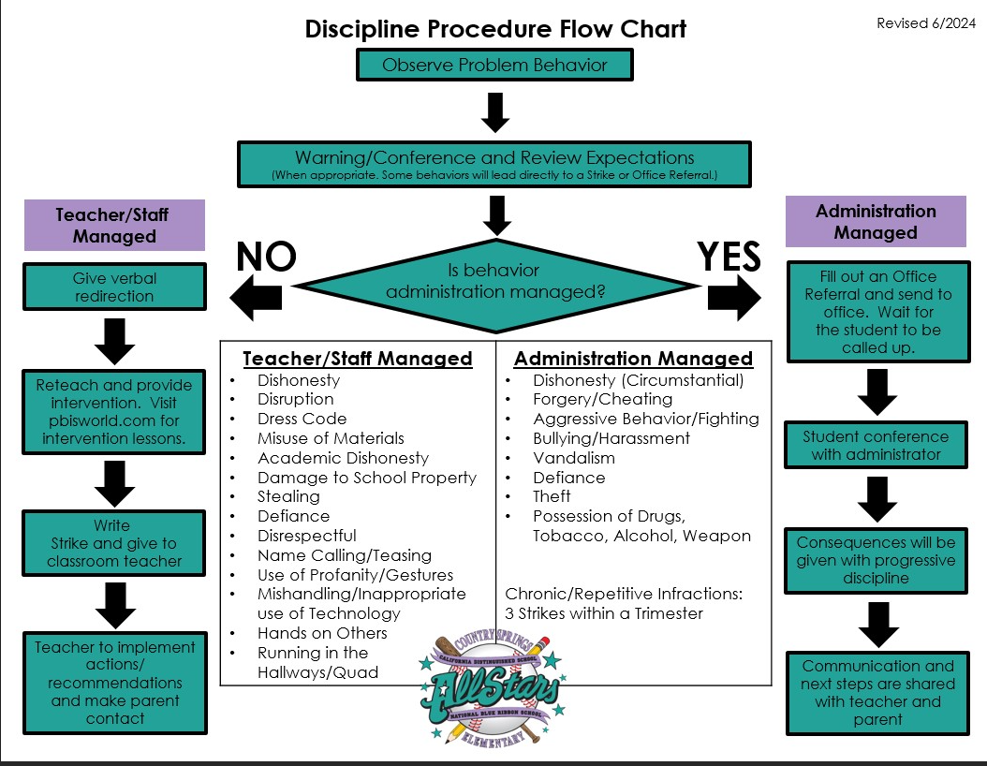

Slide 23
Please review the Game Plan
on our school website.

Slide 24
Spirit wear:
Mondays - College wear
Wednesdays - Baseball wear
Fridays - Country Spring wear
School wide Parties!:
Literature day
Holiday party
Valentine’s day
End of the year party

Slide 25
Personal headphones or noise canceling headphones to keep until the end of school
Folder (for flyers and other important paper)
Extra clothes (and maybe shoes) to keep until changed or the end of school
*Please clearly label students materials (lunch bag and water bottles too!)

Slide 26
Birthday celebration and gifts:
Make sure they are individually wrapped and grab and go to avoid academic distraction.

Slide 27
Parent Involvement
Join and plan school parties!
Attend with your child to grade level field trip and in school events.
Help volunteer grade level school events.

Slide 28
Any questions?

